Slide 1
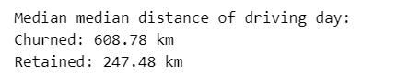
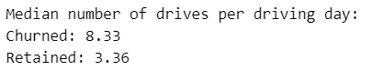
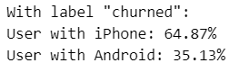
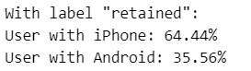
Predicts user churn project . Executive summaries
Executive summaries report
Project overview
Waze data Team was asked to analyze and interpret data, generate valuable insights, and help leadership make informed business decisions. The project is dedicated to help prevent user churn on the Waze app. Churn quantifies the number of users who have uninstalled the Waze app or stopped using the app.
The median user who churned drove 608 kilometers each day they drove last month, which is almost 250% the per-drive-day distance of retained users. The median churned user had a similarly disproporionate number of drives per drive day compared to retained users.
This dataset contains 82% retained users and 18% churned users.
The investigation revealed that within the dataset there were 700 rows without label. There is nothing to suggest a non-random cause of the missing data.
This dataset includes data about very specific type of drivers, with a high probability drivers of long-haul truckers.
The median user who churned drove 608 kilometers each day they drove last month, which is almost 250% the per-drive-day distance of retained users. The median churned user had a similarly disproporionate number of drives per drive day compared to retained users.
Initial investigation show that based on the data within dataset almost 64% users used iPhones and just 36% used Android
Initial investigation show that based on the data within dataset almost 64% users used iPhones and just 36% used Android
it would be worthwhile to recommend to Waze that they gather more data on these super-drivers. It's possible that the reason for their driving so much is also the reason why the Waze app does not meet their specific set of needs, which may differ from the needs of a more typical driver, such as a commuter.
The immediate next step is to conduct thorough EDA and develop data visualizations to illustrate the narrative behind the data and guide future project decisions.

